Slide 1
Arrays
Programming – Introduction to C++
Last modified 27/01/2016 by Conan Bourke

Slide 2
Contents
What are arrays
Using arrays
Array sizes
Iterating through arrays
Out of bounds
Copying arrays
Comparing arrays

Slide 3
What are arrays?
An array is a series of elements of the same type
An array cannot store objects of different types
E.g. No mixing floats with ints with chars
They are stored in a contiguous block of memory
Other Memory | A[0] | A[1] | A[2] | A[3] | A[4] | A[5] | A[6] | Other Memory
0x00 | 0x04 | 0x08 | ... | ... | ... | ... | ... | 0x...

Slide 4
A few rules
Array naming conventions should follow the same rules as other variables
Arrays are also scoped just like other variables
The array size defines how many elements can be stored in the array (some limits exist)

Slide 5
Declaring Arrays
//Declare an array holding 100 integers
int numbers[100];
We can specify array sizes directly like the example above.
Note that you cannot use a variable to specify the array size.

Slide 6
Array Sizes
The size of an array is dependant upon the type of object that the array stores
When declaring an array we specify the length of that array
e.g. float fastestLapTimes[10]
The actual size in memory of an array is the size of that object (in bytes) multiplied by the number of objects in that array.
In the above example, the size of the array is 10 x sizeof( float ) – or 40 bytes

Slide 7
Using arrays
Arrays are indexed from 0
Therefore if an array has 10 elements, these are accessed via indices 0-9
To access a value in an array, the index is passed to the subscript operator []
numbers[3] = 5; //Set this value to 5
numbers[3] *= 2; //Multiply it by 2
std::cout << numbers[3]; //Retrive and output to the console

Slide 8
The subscript operator
The subscript operator [] can receive any integer value
It cannot take decimal / real values (an index of 1.3323 is pointless)
The index can be given in the form of a calculation or as a variable
numbers[3 * 2] = 10;
int index = 2;
numbers[index] = 4;
int aNumber = numbers[index];
int anotherNumber = numbers[index + 1];

Slide 9
Alternative Declarations
Arrays, like other variables, can be initialised upon declaration
The difference with other variables is that the content must be defined within braces {} and values must be separated by a comma
Initialisation values are stored in left to right order.
//Declare an array holding 10 integers
int numbers[10] = {1, 2, 4, 8, 16, 32, 64, 128, 256, 512};

Slide 10
Alternative Declarations
What do you think will happen in the following declaration?
And the following?
int numbers[10] = { 1, 2, 3 };
int numbers[] = { 1, 2, 3 };
Notes:
Show them that all the remaining spaces will be initialised to zero
Show them that using an initialisation list means that no size needs to be specified inside the brackets – the compiler will determine the correct size. In this case, 3

Slide 11
Iterating through arrays
We often want to access the elements of an array sequentially
The most common way of doing this is by using a for loop:
int someArray[10] = {1, 2, 3, 4, 5, 6, 7, 8, 9, 10};
for(int i = 0; i < 10; ++i)
{
std::cout << someArray[i] << std::endl;
}

Slide 12
For each
For each loops are specifically designed to work with collections of objects – such as arrays
We can think of this as: for each integer in someArray then do the statements with the braces
We give a label to the current integer that is being processed, in this case, i
int someArray[10] = {1, 2, 3, 4, 5, 6, 7, 8, 9, 10};
for(int i : someArray)
{
std::cout << i << std::endl;
}

Slide 13
Out of bounds
If an index is beyond the scope of the array, e.g. trying to access element 100 in an array of 90 objects, then bad things can, and will happen!
//Declare an array holding 10 integers
int highScores[10];
//Later in code....
//If an improperly addressed element is being assigned to a variable
//The value returned will be undefined and in this scenario certainly
//not a valid score.
int highScore = highScores[15]; //Out of bounds!!

Slide 14
Boundaries
Things will only get worse if an element that is beyond the scope of an array is attempted to be written to
This is called buffer overflow and often results in seemingly random behaviour...or a crash
Sometimes the debugger will detect a buffer overflow (but not always) resulting in one of the following errors:
The stack/heap around ‘array’ was corrupted
Subscript index for ‘array’ is out of bounds

Slide 15
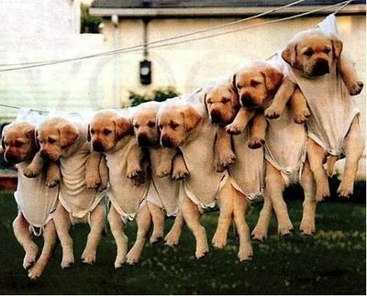
Array Types
Arrays can be of any type, so long as that type is defined somewhere within the scope of the project
These arrays are defined and accessed in the same way as integer arrays

Slide 16
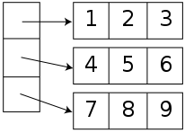
Arrays of arrays
Since arrays can be of any type then it makes sense that we can have arrays of other arrays
These are called 2 dimensional arrays

Slide 17
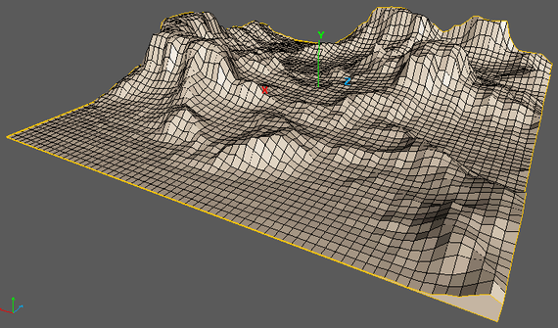
2D Arrays
2 Dimensional arrays consist of both rows and columns of elements
For example we might have a simple 2D map with the value stored in the array describing the height of each point (a height map)
The array consists of 3 rows and 3 columns
To create an array to represent this format we declare it like this:
int map[3][3];
5 | 5 | 7
4 | 5 | 6
3 | 4 | 5

Slide 18
2D Arrays Continued
2D Arrays can be initialised on declaration just like 1D arrays. Just needs an extra set of '{ }‘
You can think of it, as an array of arrays. In this case, 3 sets of integer arrays 4 elements long
The first number in the [] brackets represents the rows and the second represents the columns
int map[3][4] = {{ 128, 256, 128, 64 },
{ 64, 192, 256, 64 },
{ 0, 256, 128, 128 } };

Slide 19
Accessing 2D array elements
The code above will output the element on the third row and second column of the map array
To iterate through a 2D array we usually use nested for loops
std::cout << map[2][1];
for (int row = 0; row < 3; ++row)
{
for (int col = 0; col < 3; ++col)
{
std::cout << map[row][col];
}
}

Slide 20
Storage
A multi-dimensional array is stored in memory as a linear sequence of elements, just like a one-dimensional array
 | Other Memory |  |  |  | map[0][0] |  |  |  | map[0][1] |  |  |  | map[0][2]
Bytes | 0 | 1 | 2 | 3 | 4 | 5 | 6 | 7 | 8 | 9 | 10 | 11 | 12 | 13 | 14 | 15
 | map[1][0] |  |  |  | map[1][1] |  |  |  | map[1][2] |  |  |  | map[2][0]
Bytes | 16 | 17 | 18 | 19 | 20 | 21 | 22 | 23 | 24 | 25 | 26 | 27 | 28 | 29 | 30 | 31
 | map[2][1] |  |  |  | map[2][2] |  |  |  | Other Memory |  |  |  | Other Memory
Bytes | 32 | 33 | 34 | 35 | 36 | 37 | 38 | 39 | 40 | 41 | 42 | 43 | 44 | 45 | 46 | 47
Multiple indices are mapped to a single index into memory

Slide 21
1D vs 2D
It’s actually more common to use a 1D array that simulates the behaviour of a 2D array
However while you are learning it may be easier to conceptualise a 2D array
int map[3][3] = { { 1, 2, 3 }, { 4, 5, 6 }, { 7, 8, 9 } };
int map2[9] = { 1, 2, 3, 4, 5, 6, 7, 8, 9 };
int row = 1, col = 2;
std::cout << map[row][col];
std::cout << map2[row * 3 + col];
Notes:
1D arrays are faster for reasons they will learn about much later

Slide 22
n-dimensional arrays
You can have any number of dimensions in your array
You can have 3D arrays:
int voxelCube[3][4][6];
4D arrays:
int MyHeadHurts[3][4][5][6];
And so forth, although they do get a little hard to visualise, but not impossible!

Slide 23
Danger!
C++ does not permit a simple array to array copy using the assignment operator =
Elements must be copied individually, or copied as part of a block memory copy
int highScores[10];
int newScores[10];
//Copy each element individually
for(int i = 0; i < 10; i++)
{
newScores[i] = highScores[i];
}

Slide 24
Danger!
Similarly, you cannot compare two arrays with the == operator
Elements must be compared individually
int highScores[10];
int newScores[10];
/*
add some values into the arrays
*/
bool match = true;
for (int i = 0; i < 10; i++)
{
if (newScores[i] != highScores[i])
match = false;
}
Notes:
We will explain the reasoning for this more deeply in the coming weeks.

Slide 25
Outputting arrays
When outputting an array we cannot do the following:
Like comparing or copying, we need to output element by element:
int highscores[10];
std::cout << highscores;
int highscores[10];
for (int i = 0; i < 10; i++)
{
std::cout << highscores[i] << " ";
}

Slide 26
Summary
Arrays are extremely useful when we want to create a list or collection of objects of the same type
By using arrays and loops together, you can avoid needing to write large portions of code
Arrays are a bit trickier to pass into functions and you need to copy each individual element one at a time should you wish to copy an entire array.

Slide 27
References
Prata, S, C++ Primer Plus, 6th Ed, Addison-Wesley Professional (2011)

